Slide 1
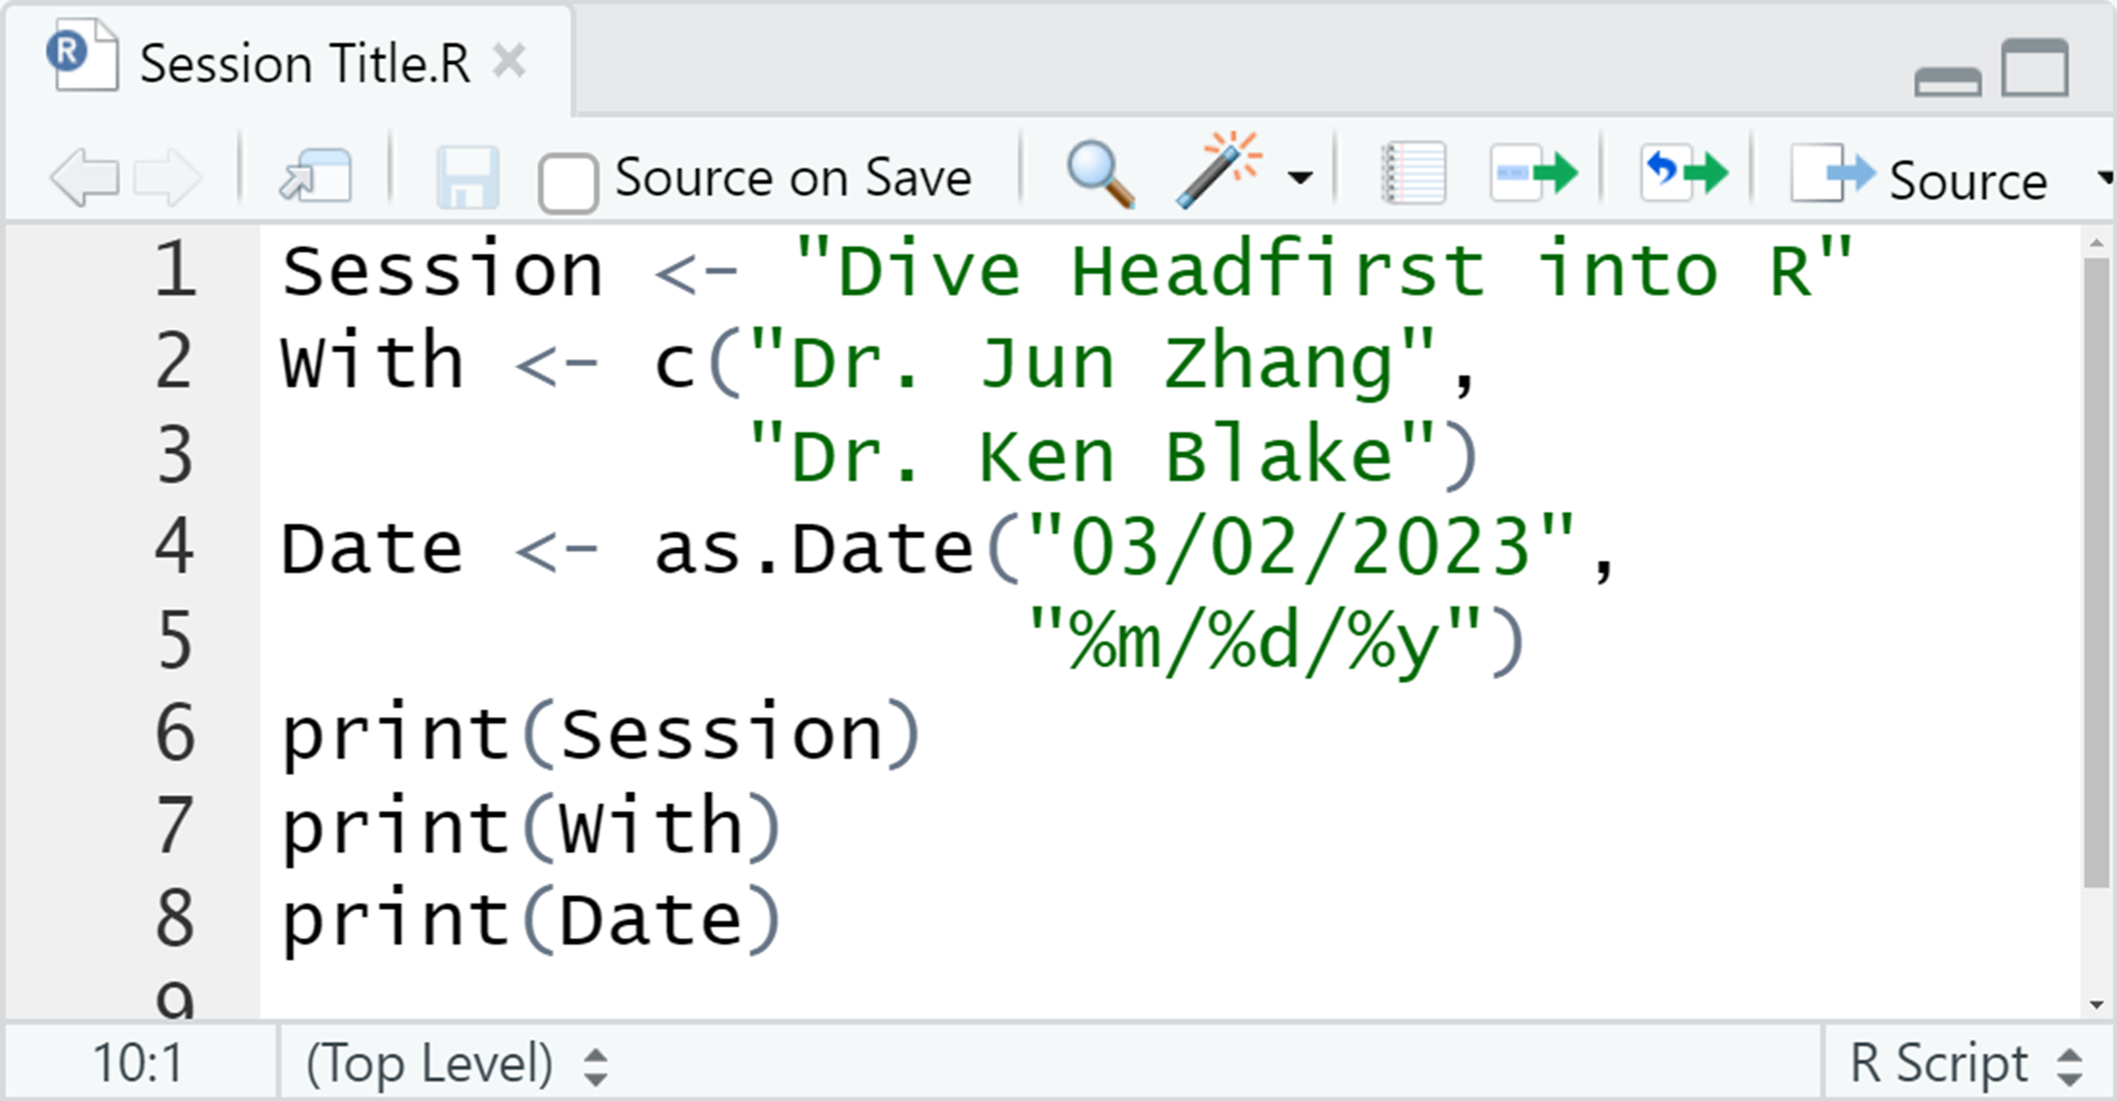
Part 1

Slide 2
You don't have to remember every single R command.
Feel free to Google it when you need to!
Source: Reddit

Slide 3
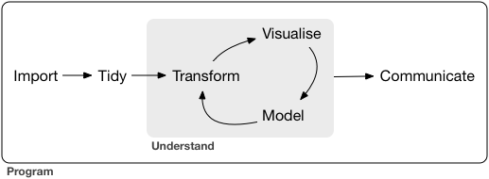
Data science with R workflow
Source: R for Data Science

Slide 4
R & RStudio
The R programming language is widely used among statisticians and data miners for statistical computing and graphics.
R is a software environment to process R programming languages.
RStudio is an integrated development environment for R programming.

Slide 5
R & RStudio
If R is the engine and bare bones of your car, then RStudio is like the rest of the car. The engine is super critical part of your car. But in order to make things properly functional, you need to have a steering wheel, comfy seats, a radio, rear and side view mirrors, storage, and seatbelts.
RMarkdown for Scientists Nicholas Tierney

Slide 6
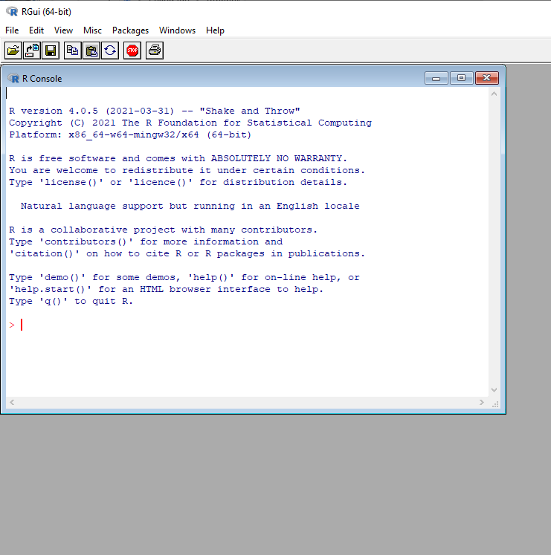
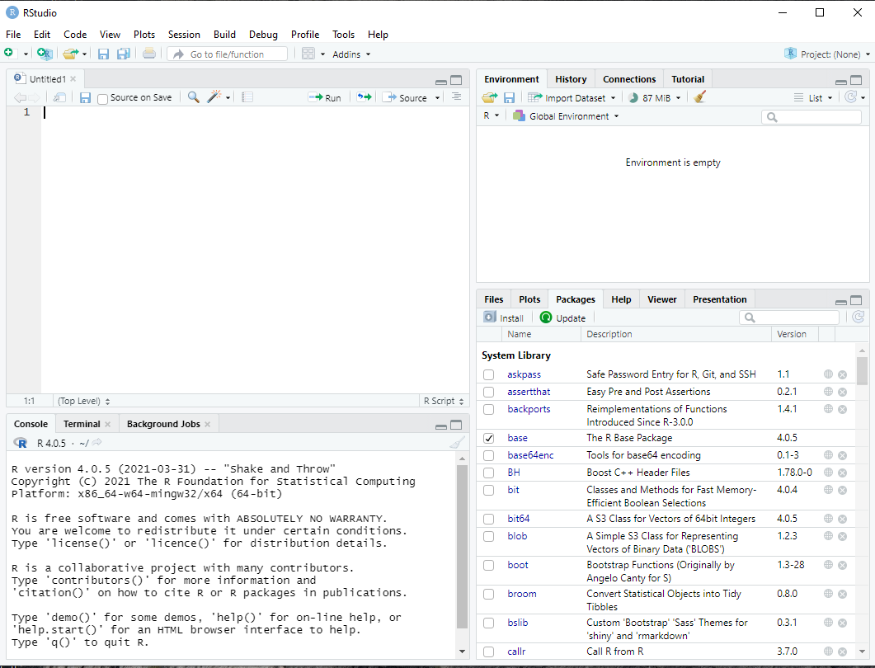
R & RStudio
R interface
RStudio interface

Slide 7
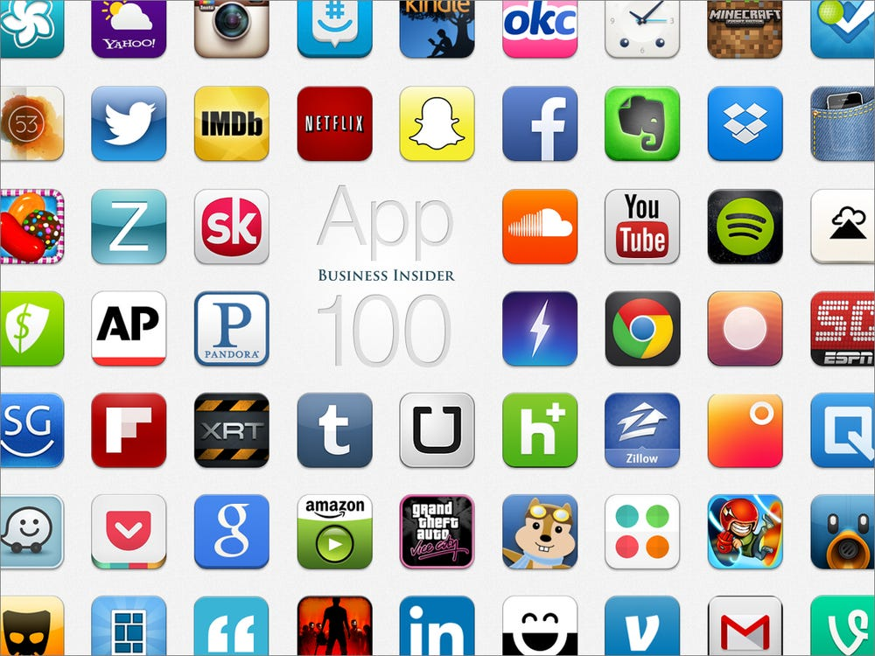
Packages
An R package is a collection of functions, data, and documentation that extends the capabilities of base R.
The packages installed are not loaded by default.
You will not be able to use the functions, objects, and help files in a package until you load it.
R
R packages

Slide 8
Packages
tidyverse: include all the packages required in the data science workflow, ranging from data exploration to data visualization.
Data Visualization and Exploration: ggplot2
Data Wrangling and Transformation: dplyr, tidyr, stringr, forcats
Data Import and Management: tibble, readr
Functional Programming: purr
lubridate: helps users to easily manipulate date and time data. It provides tools for parsing, formatting and manipulating dates and times.
rtweet: collect and organize Twitter data via Twitter’s REST and stream API
plotly: creating interactive web-based graphs via the open source JavaScript graphing library plotly. js
Source: https://www.geeksforgeeks.org/what-are-the-tidyverse-packages-in-r-language/

Slide 9
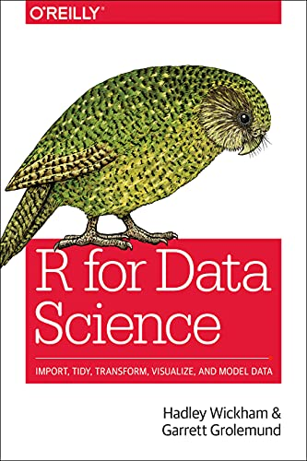
Resources
https://posit.cloud/
Learning statistics with R - https://learningstatisticswithr.com/book/
R for Data Science - https://r4ds.had.co.nz/
Data Visualization - https://socviz.co/
https://www. geeksforgeeksorg/

Slide 10
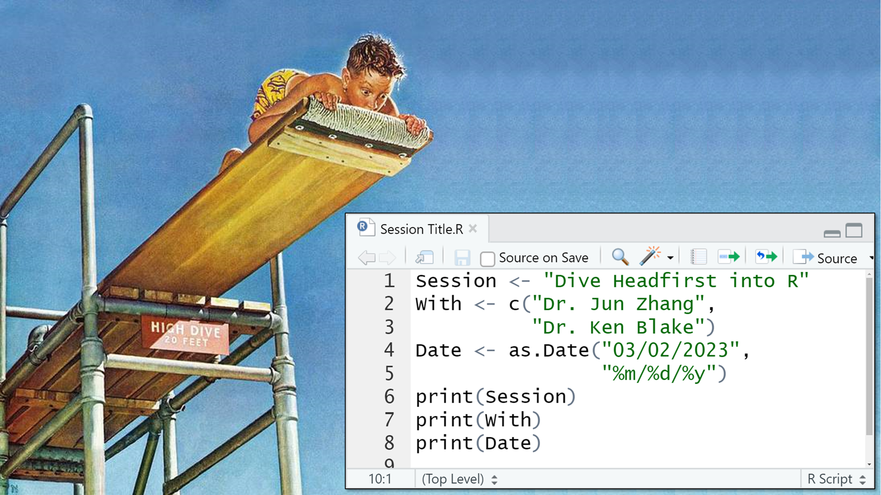
Part 2

Slide 11
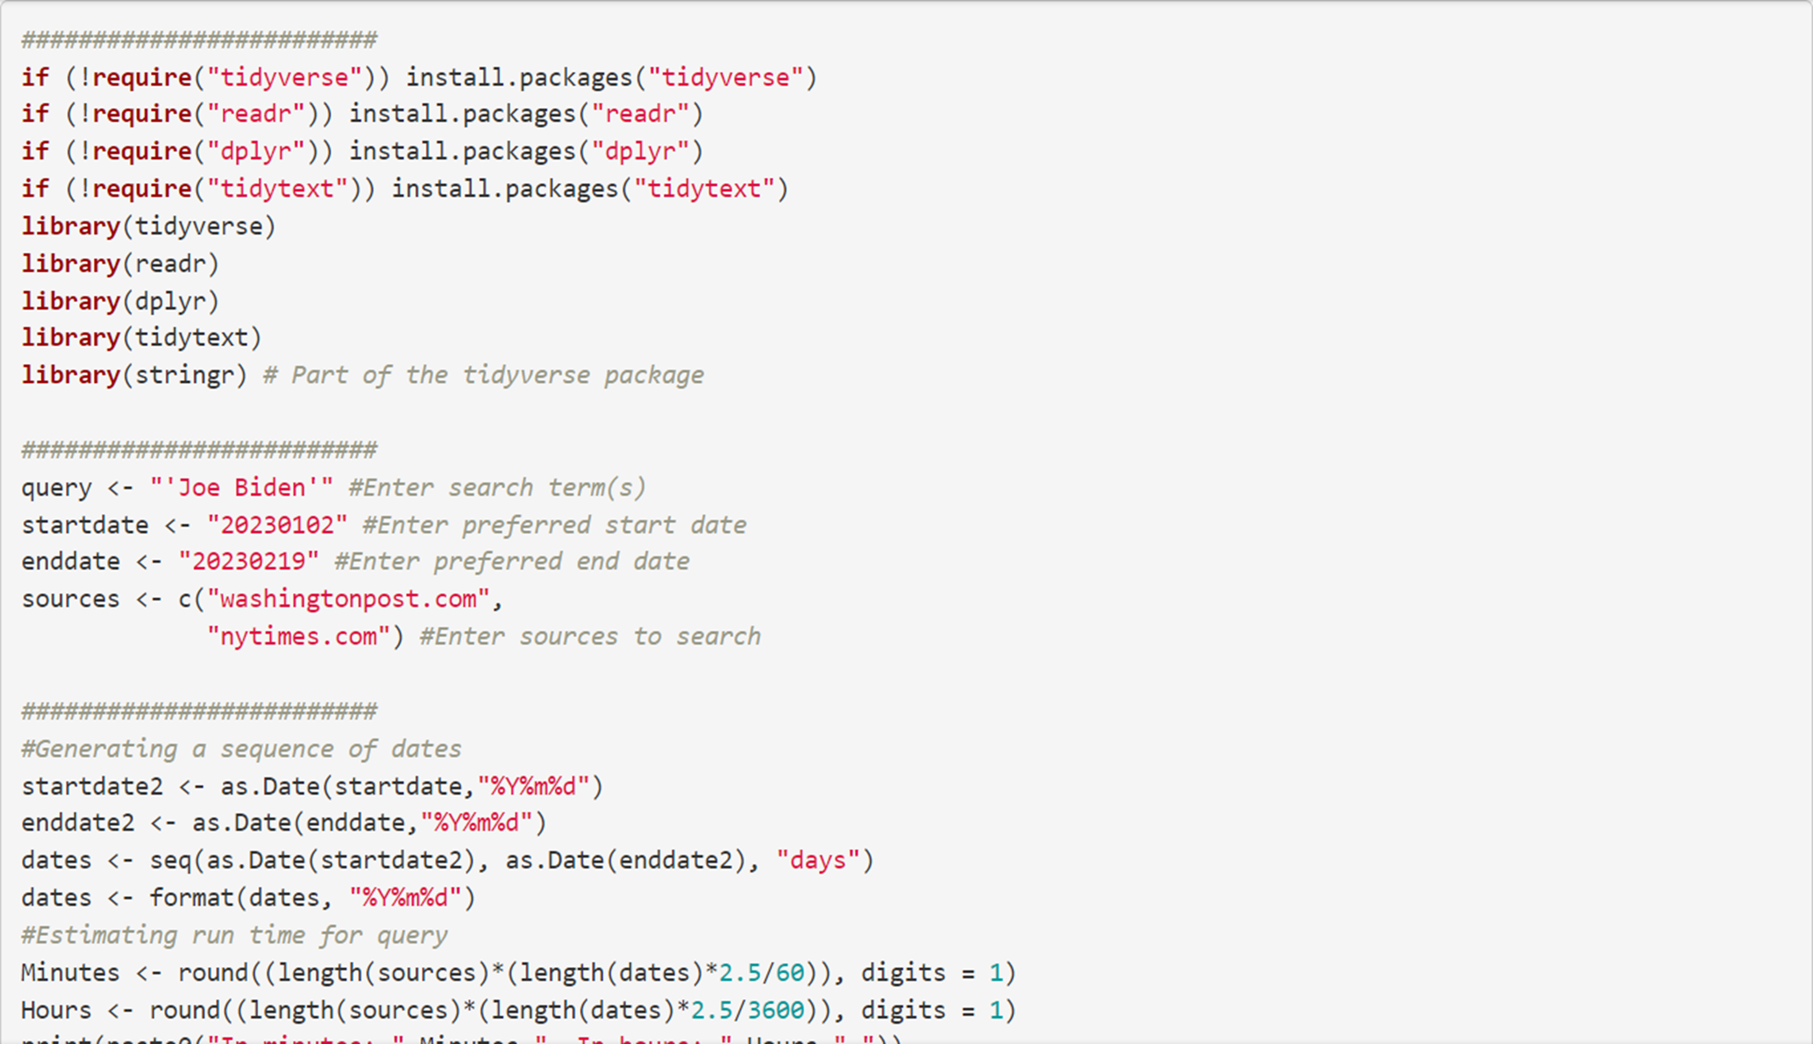
Plunge incentive:
Look at what this one script can do for you.
Specify search terms, dates, and sources ...

Slide 12
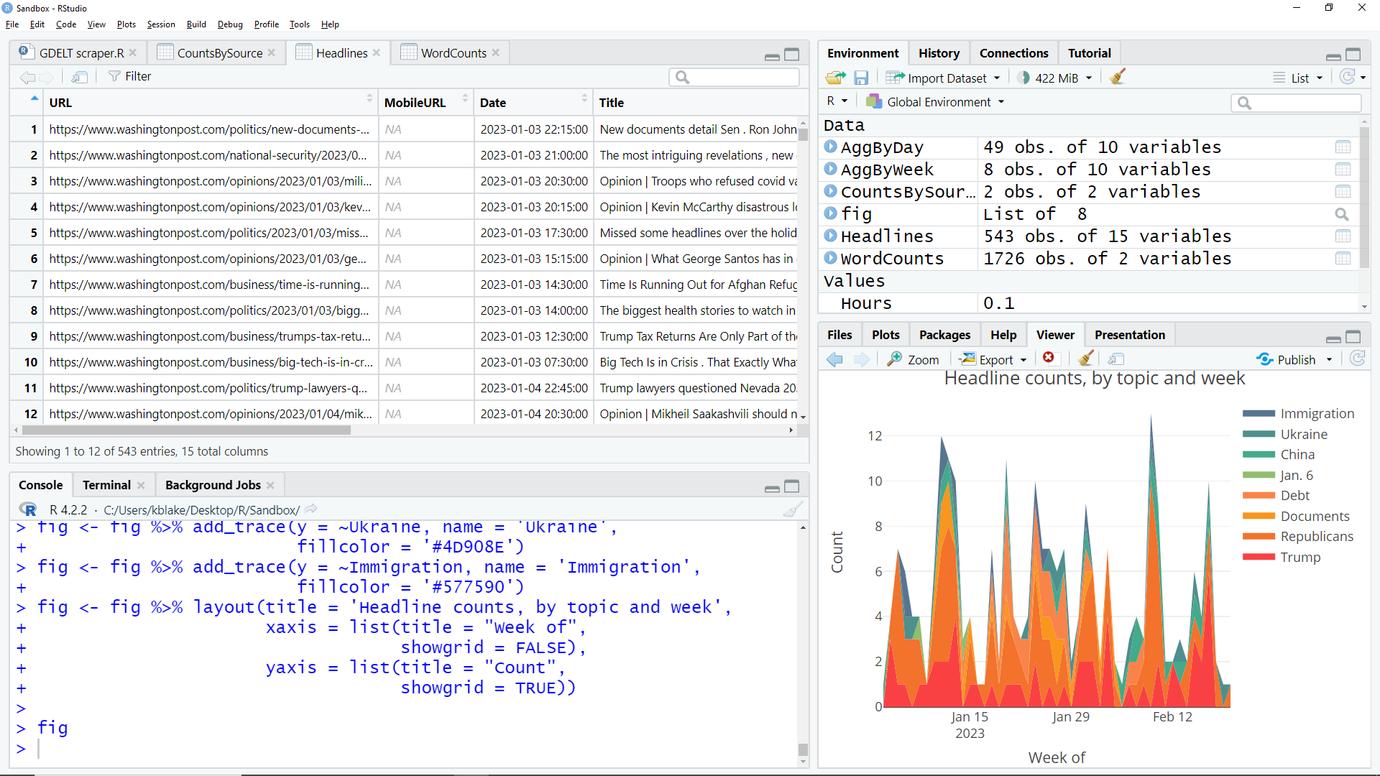
In this case, 543 of them.
In about 4 minutes.
… and get the URL, pub date & headline for every matching article.

Slide 13
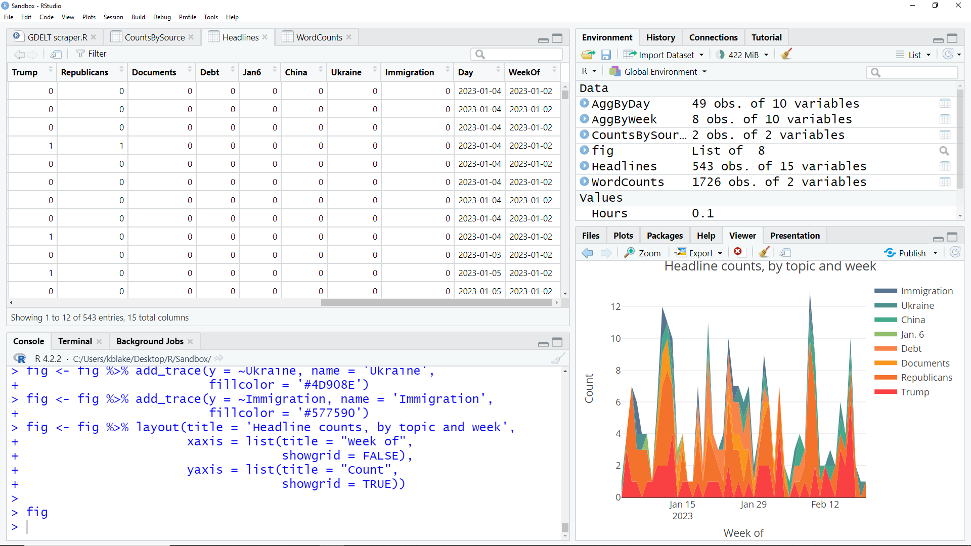
Headlines autocoded for mentions of user-defined topic keywords.

Slide 14
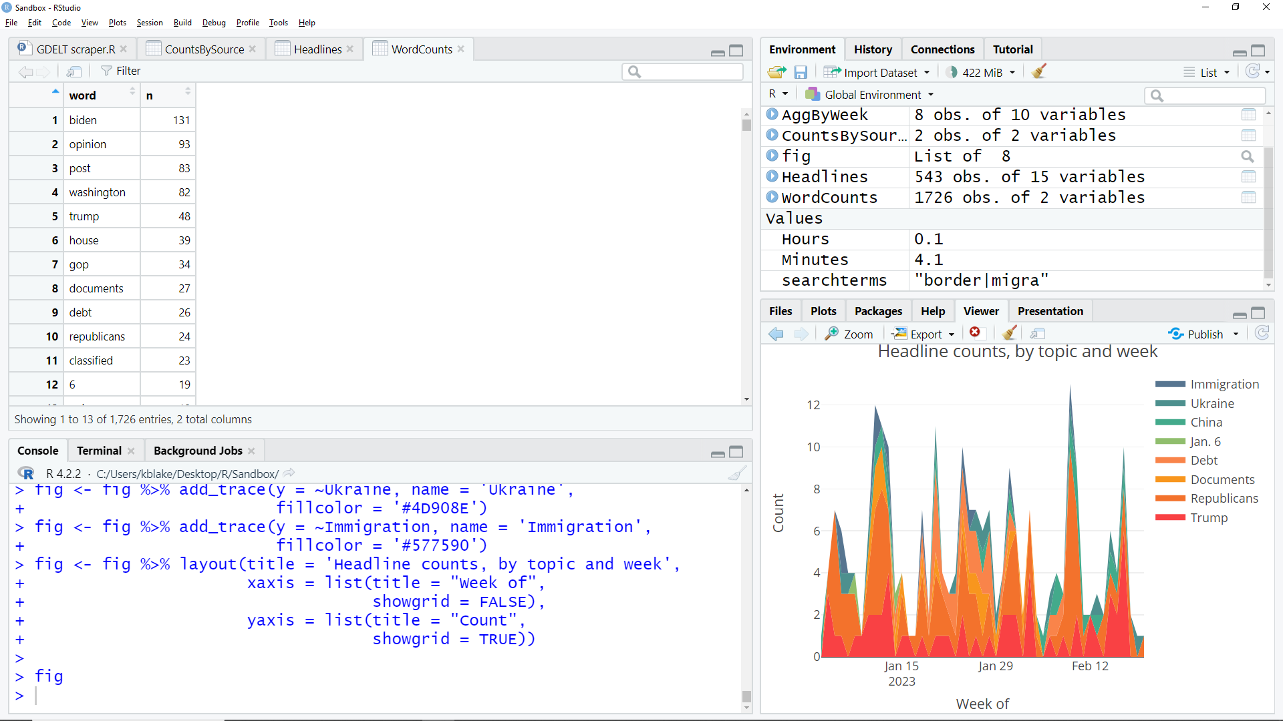
A headline word frequency analysis to help identify topics.

Slide 15
A graph showing each topic’s daily volume across the period searched. Plus …

Slide 16
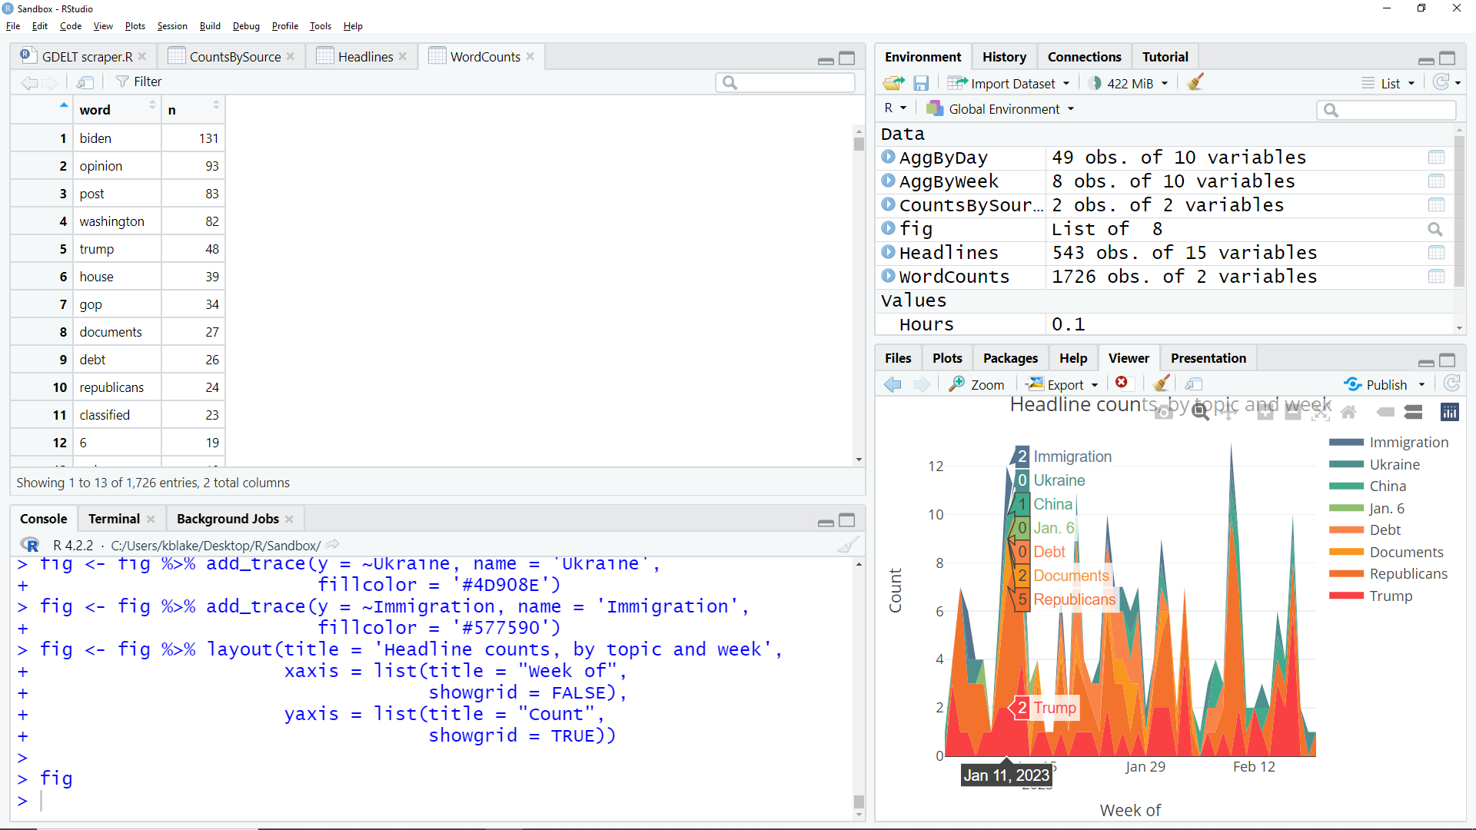
… “mouse over” interactivity, and …

Slide 17
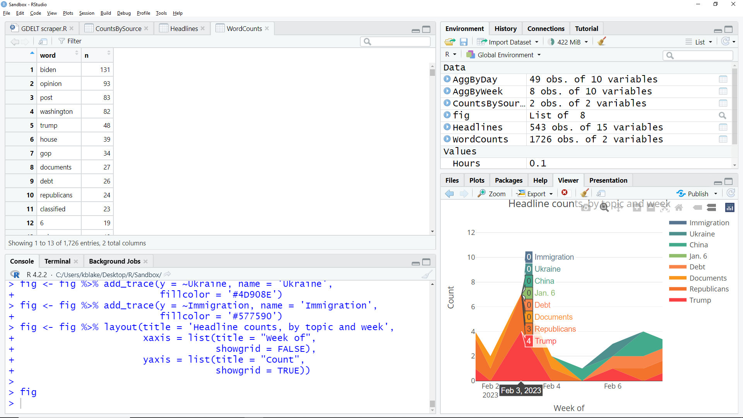
(And customizable colors.)
… “mouse over” interactivity, and …
… zoomability.

Slide 18
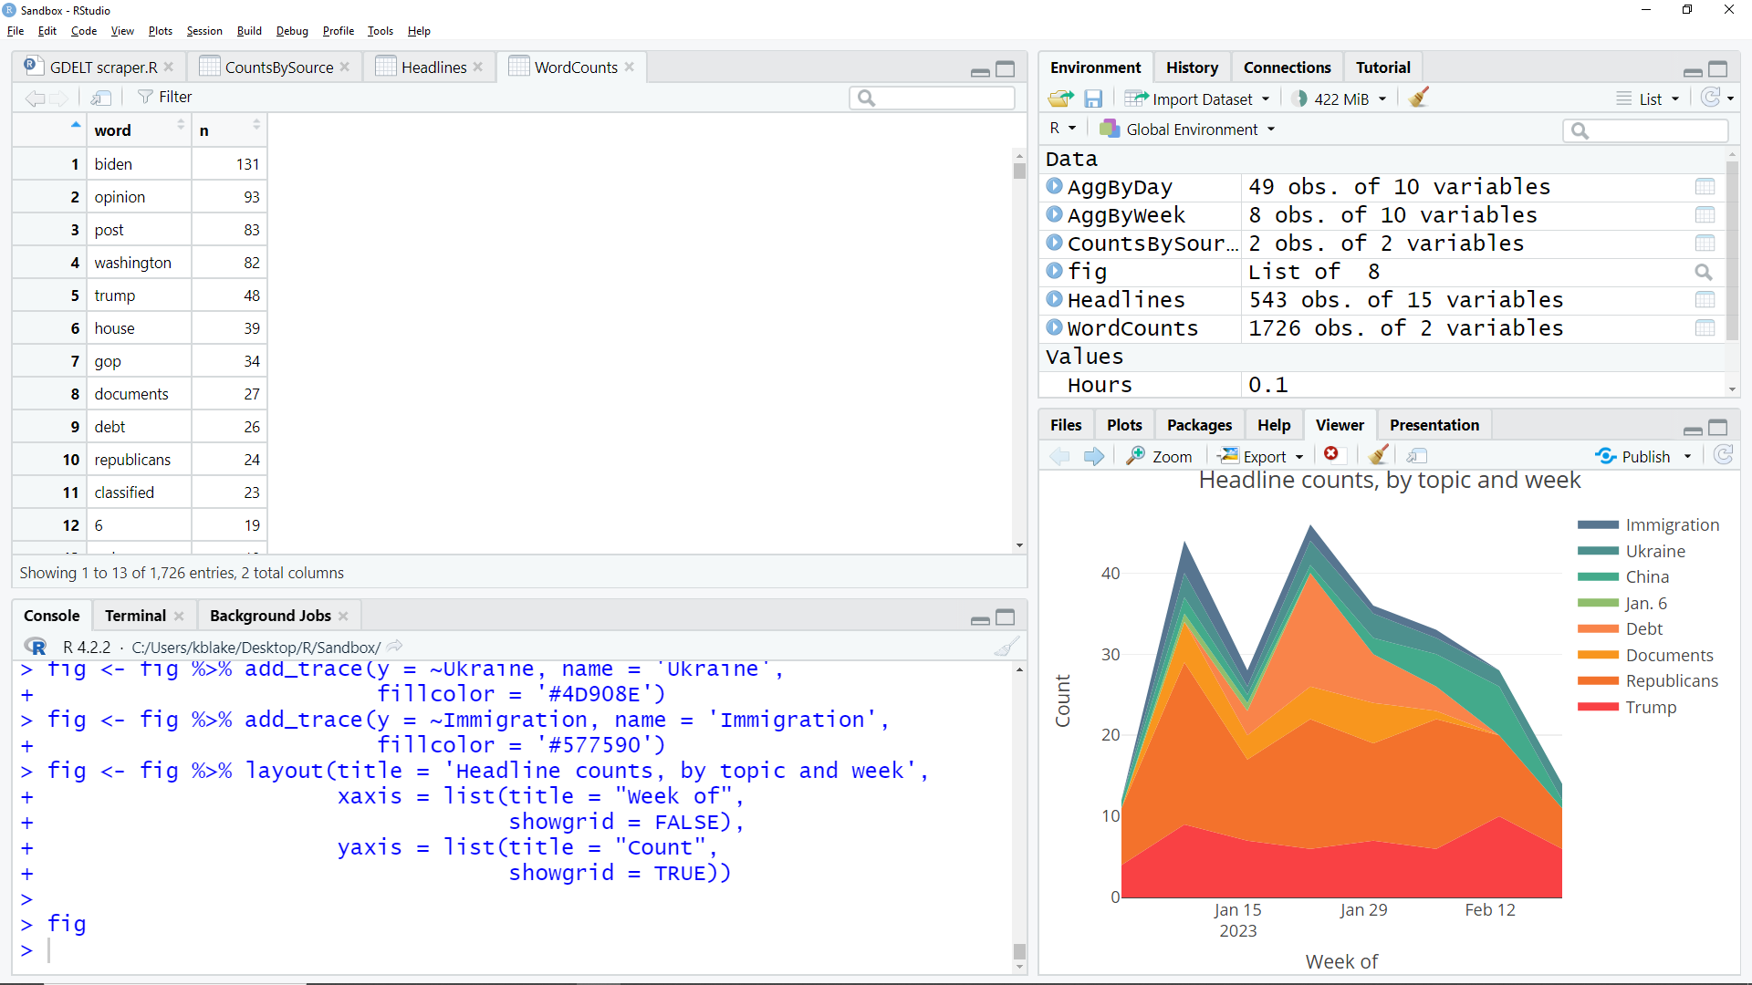
A graph of the same data, but by week …

Slide 19
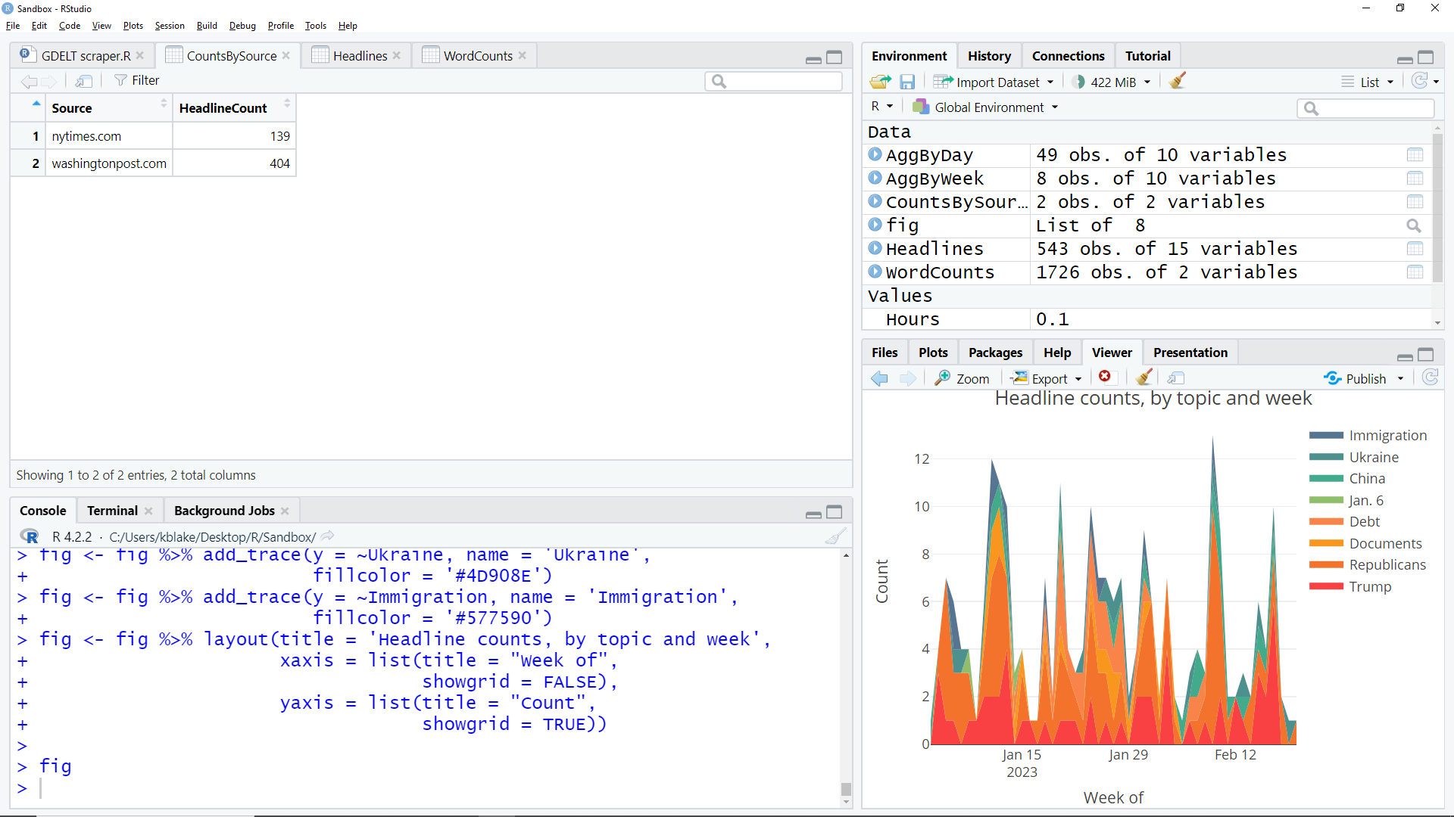
… the number of articles captured, by source …

Slide 20
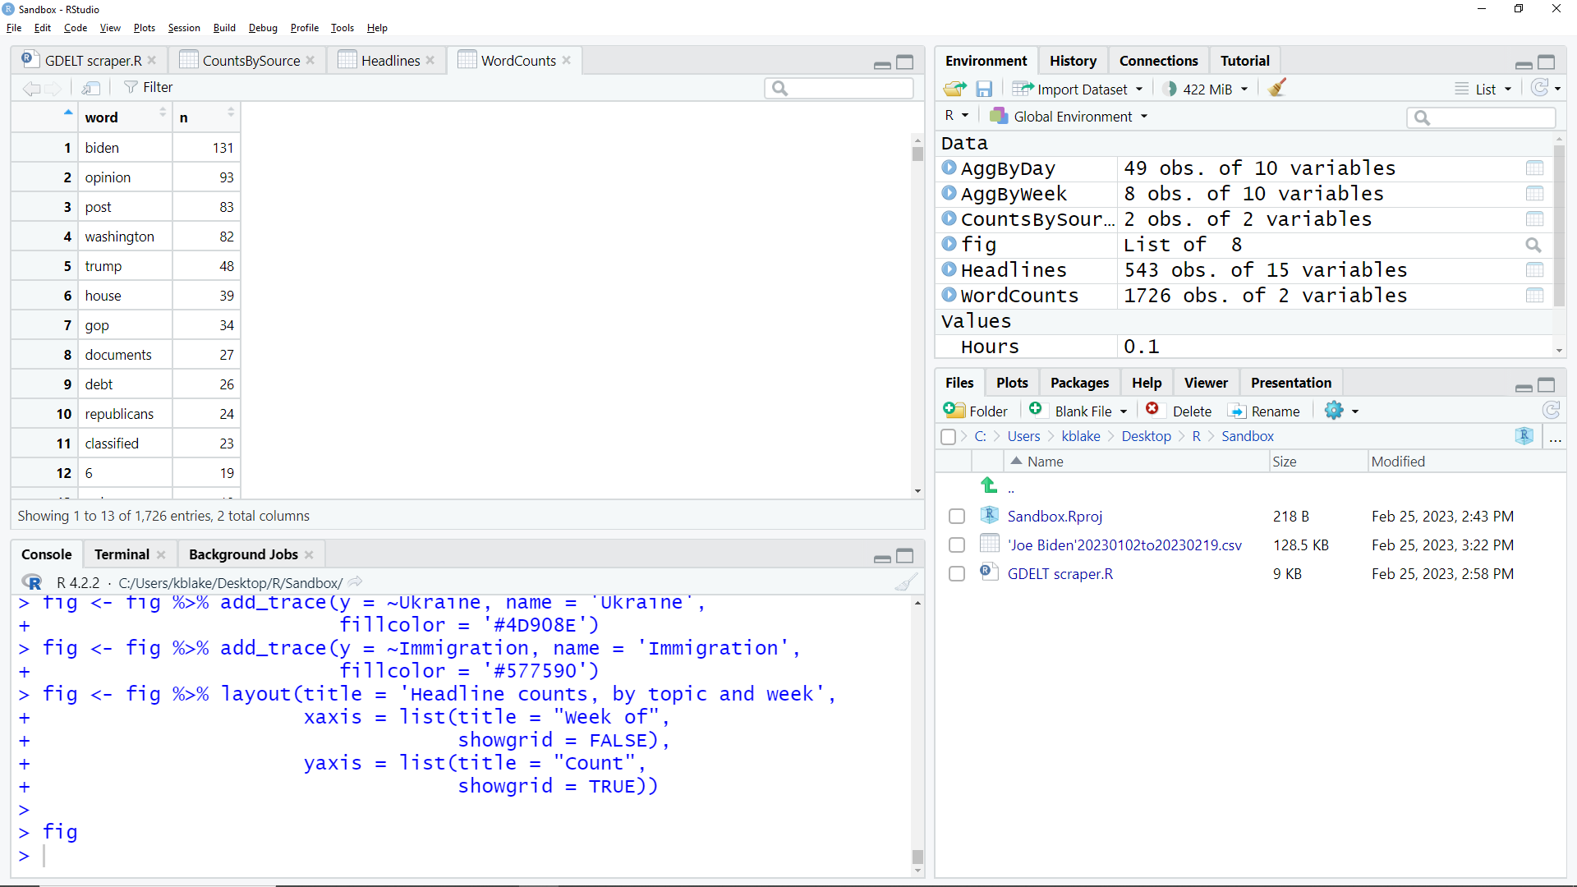
… and the data, exported as a .csv file automatically named after your search terms and date range.

Slide 21
Retrieve data for as many articles as you want, back to 2017 …
… about any topic you can devise search terms for …
… published in any indexed source, regardless of country or language …
… for free.

Slide 22
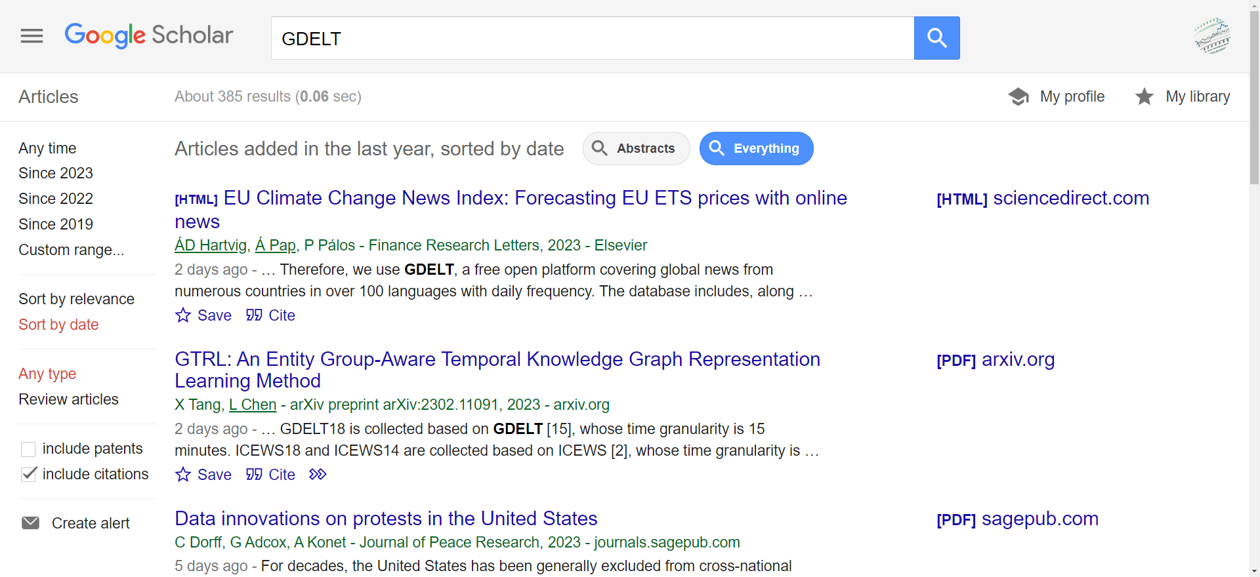
Data come from GDELT, the Global Database of Events, Language and Tone.
Google Scholar lists about 385 articles citing GDELT in the last year.

Slide 23
The script has 247 lines of R code.
But you can start using it today if you can learn how to tweak fewer than a dozen of them.

Slide 24
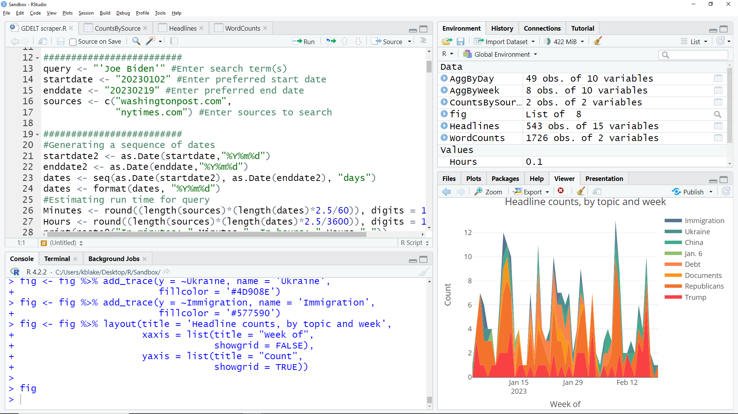
The “query” line is where you specify your search terms.

Slide 25
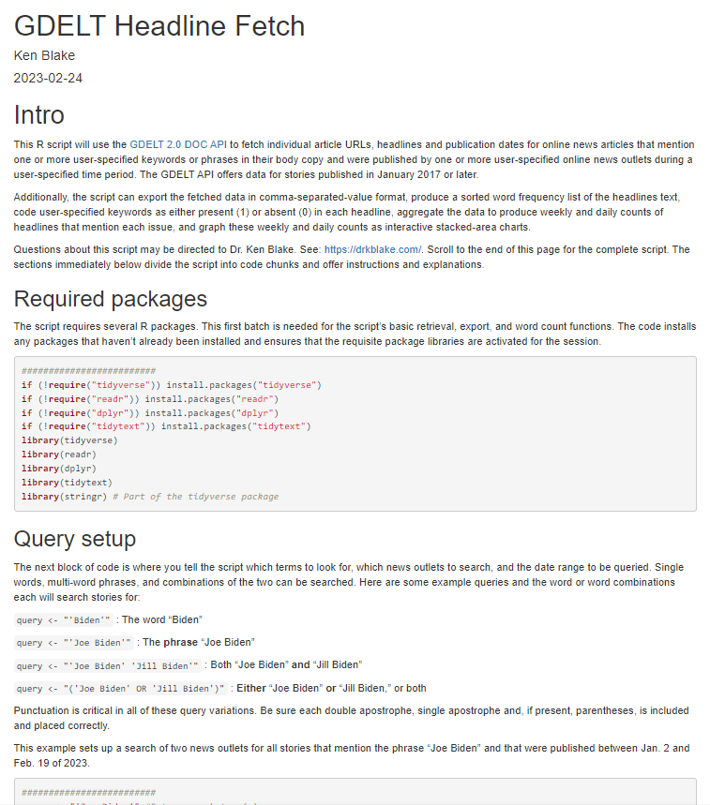
Incidentally, all hints I’ll go over are covered in the script’s companion web page.
See:
https://rpubs.com/drkblake/1007551
Also there: A full copy of the script.
You can have a copy of this PowerPoint, too.

Slide 26
Specify a “startdate” for your search in YYYYMMDD format.
Specify an “enddate” in the same way.

Slide 27
Add as many sources as you like, using the root of the source’s web address.
Punctuation matters … a lot.

Slide 28
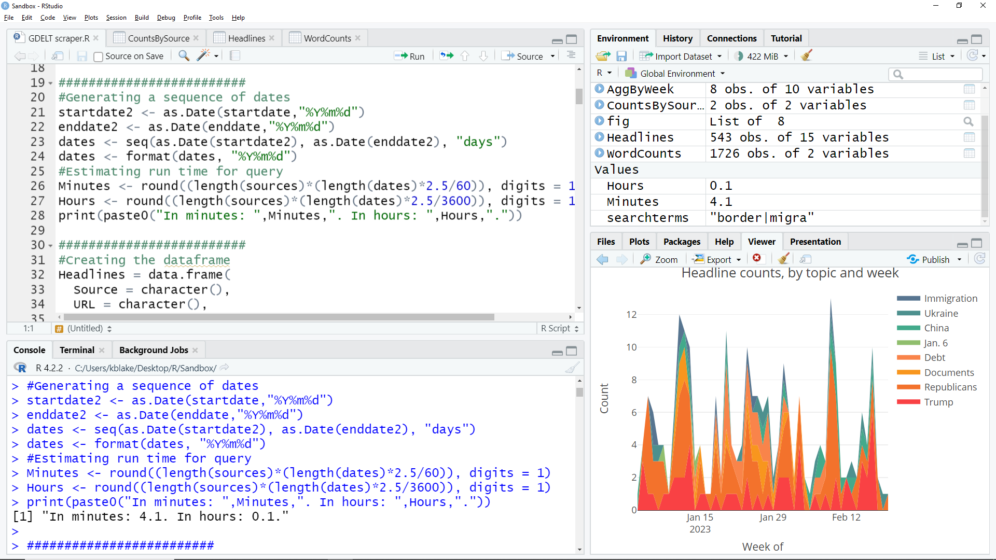
The bigger your date range and source list, the more time the query will take.
Running this code will give you an estimate of the time required.

Slide 29
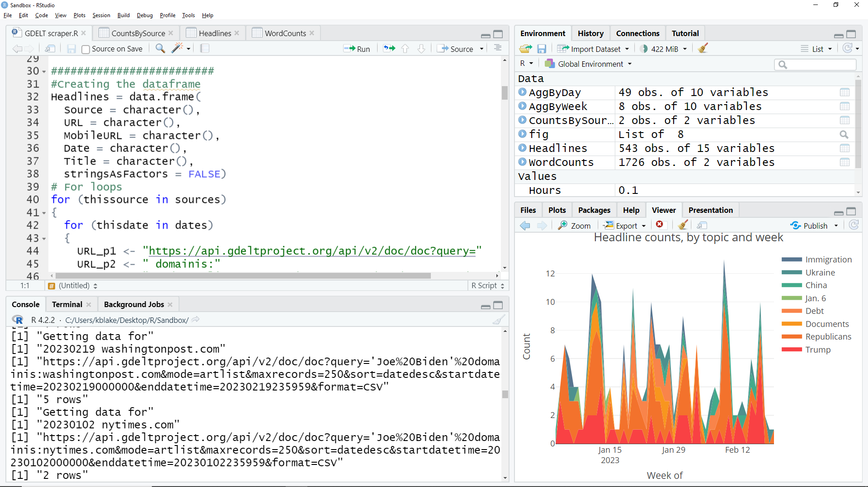
This code starts a “loop” that sends the GDELT API a request – one at a time – for each search terms/source/date/ combination.
Each result shows here as the loop runs.

Slide 30
Each iteration adds data to the “Headlines” data frame.
Stop the loop, and “Headlines” will contain all data collected so far.

Slide 31
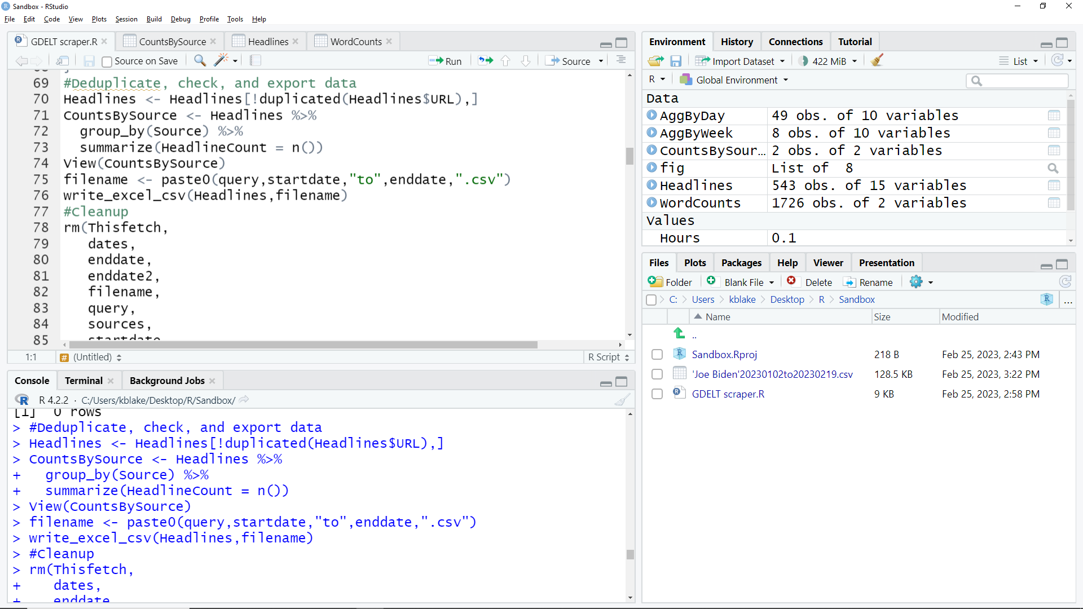
After the loop, a built-in process deletes any duplicate records.

Slide 32
1
This code will show you the number of articles retrieved per source.
2
The %>% operator (from the dplyer package) basically means “and then …”
After the code runs, click this tab to see the summary.

Slide 33
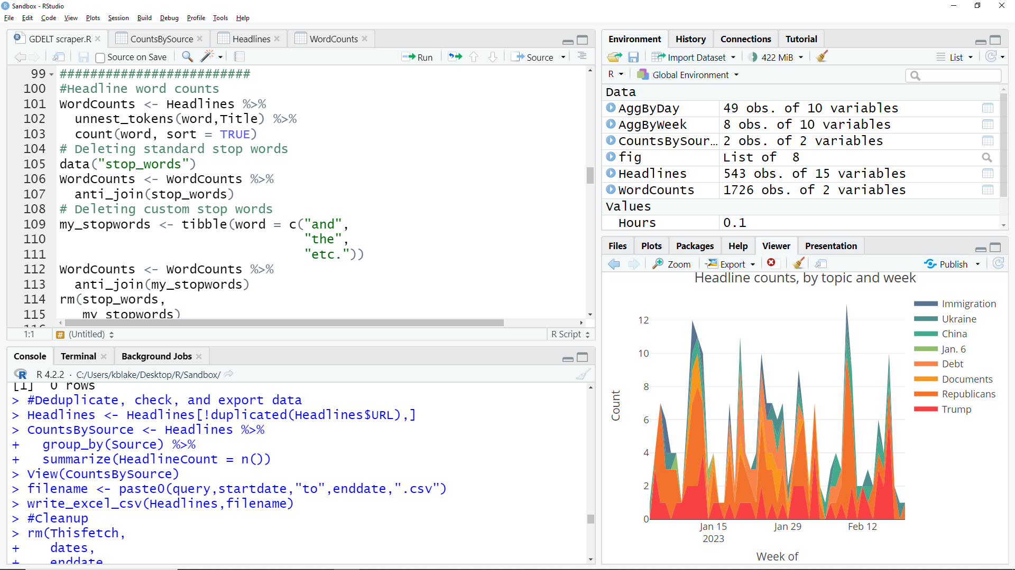
This code deletes common “stop words” from the headline word count.

Slide 34
You can add custom stop words here.

Slide 35
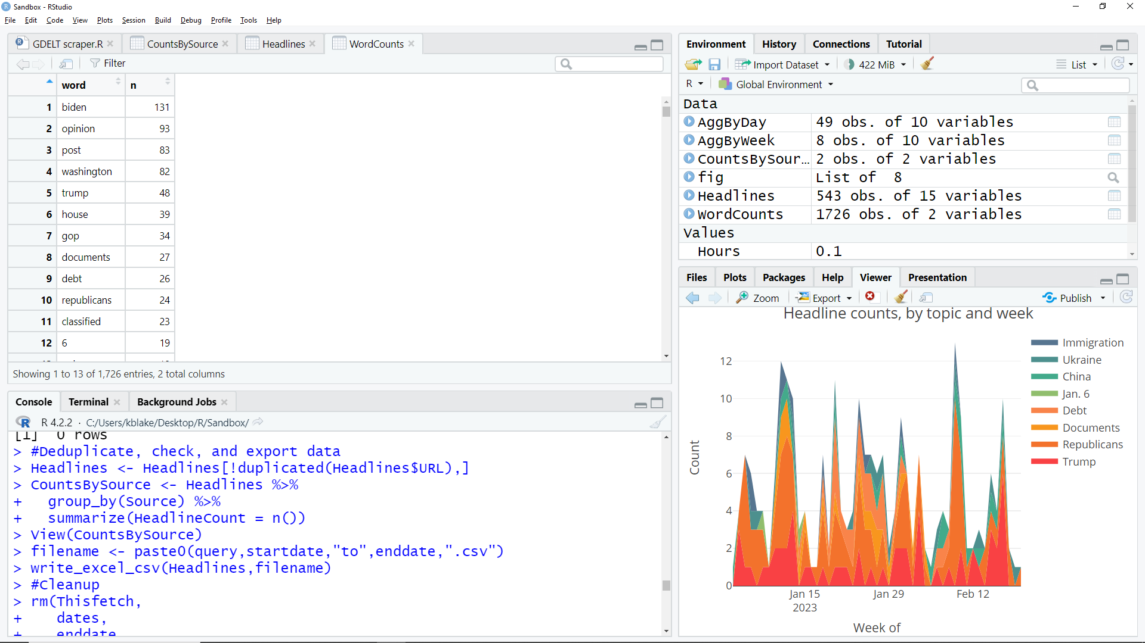
Sorted headline word counts are under this tab, and they look like this.

Slide 36
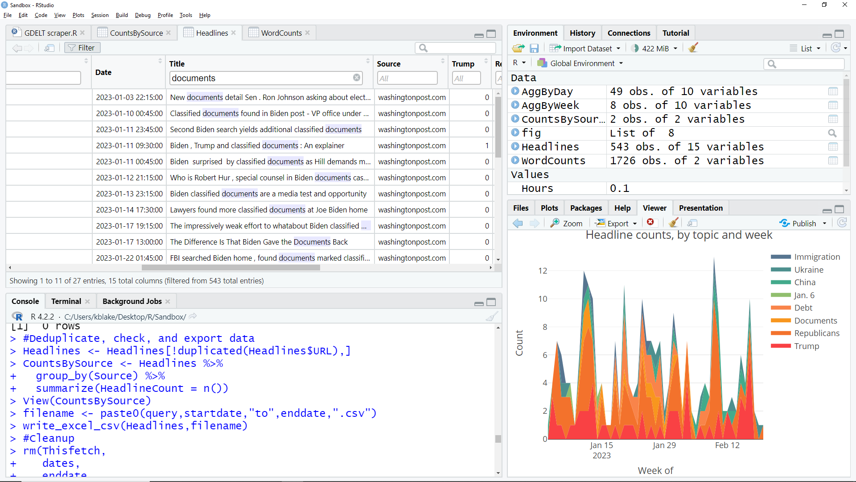
1
2
On the Headlines tab, you can filter the headlines by keyword to explore how each keyword is used.
Here, you see that many – but not all – headlines mentioning “documents” are about Biden’s “classified documents.”

Slide 37
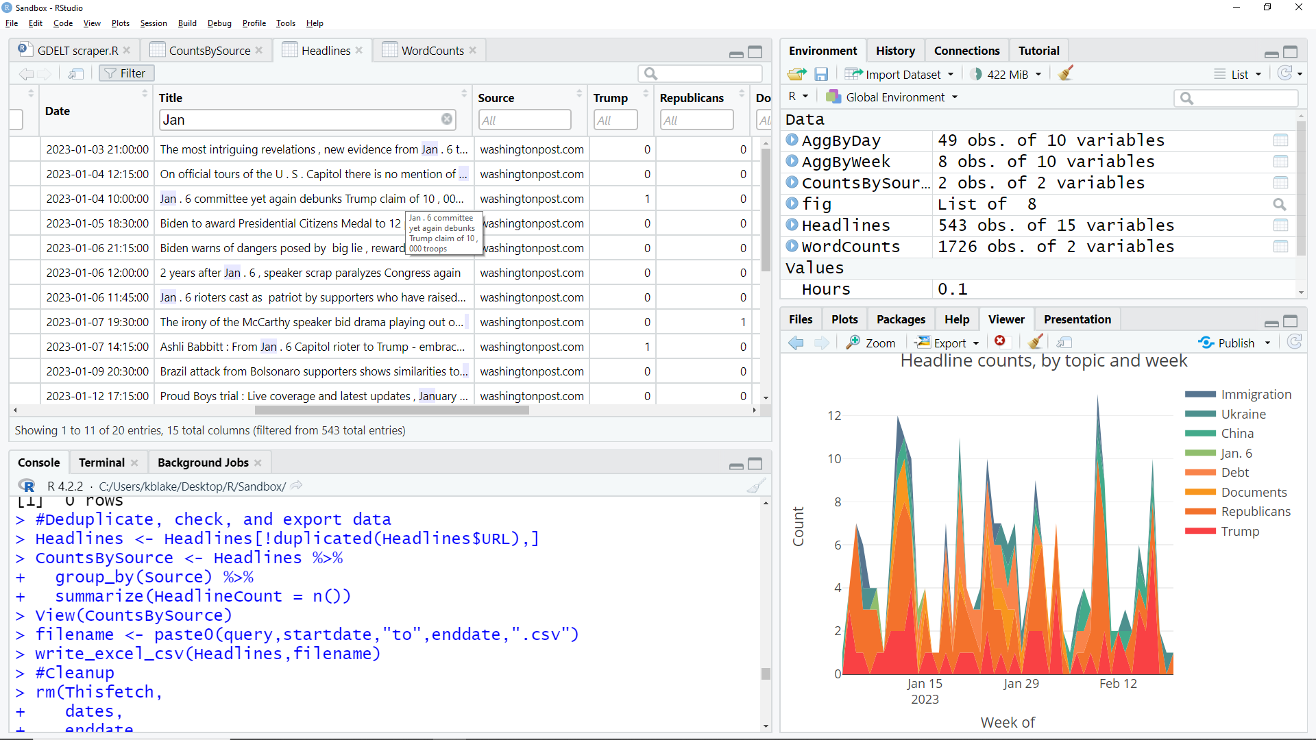
The same method shows than “Jan. 6” will flag headlines about the Jan. 6 capitol riot.
A mouse hover will show you the full text of any cell.

Slide 38
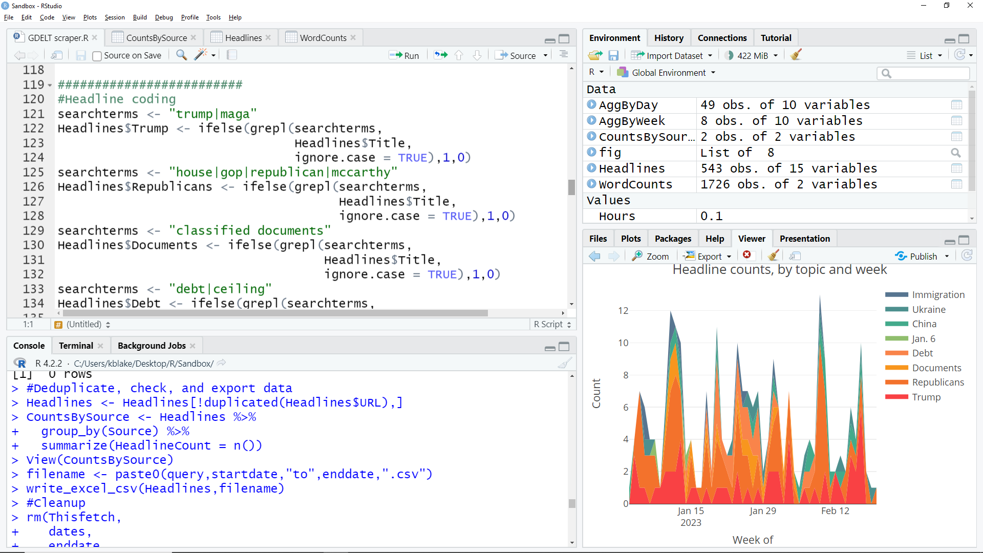
You can then customize this code to categorize headlines by keywords.
Here, a headline gets a “1” if it mentions “trump” or “maga” & a “0” if it doesn’t.
The codes end up stored in a dataset column called “Trump.”

Slide 39
“Or,” represented by a “|” character, is the only Boolean operator available, here.
But the search is string-based. For example, “trump” will find “Trump” but also “Trump’s,” “Trumpism,” “Trumpian,” etc.

Slide 40
Replicate the code – with those two aspects altered – for each headline categorization you want to do.
This code creates a column called “Republicans” …
… and codes it as a “1” if the headline includes any of these terms.

Slide 41
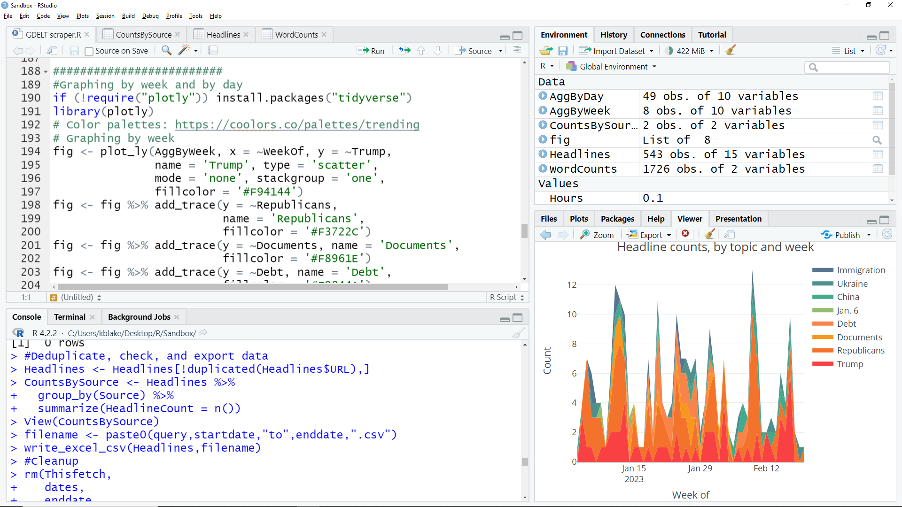
Also, be sure each headline categorization column’s name gets added to the chart code, along with …

Slide 42
… labels for the chart’s legend.
Also, be sure each headline categorization column’s name gets added to the chart code, along with …

Slide 43
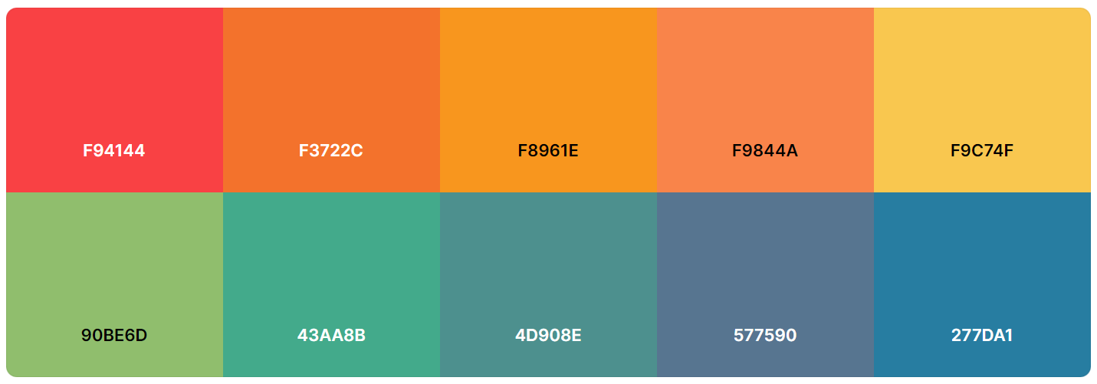
Edit these color codes to change the chart’s colors. I used a palette from Coolors.co.

Slide 44
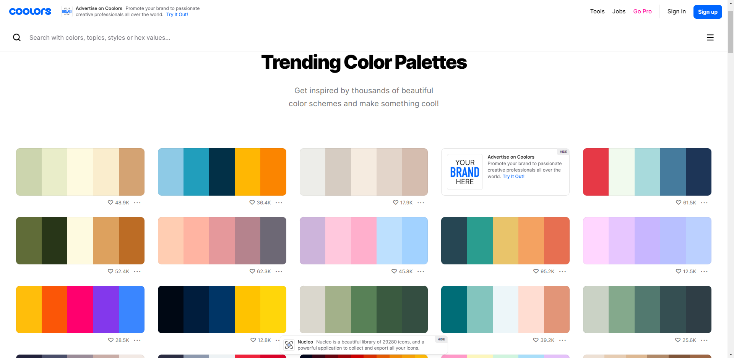
Lots of options are available.
Edit these color codes to change the chart’s colors. I used a palette from Coolors.co.

Slide 45
Once made, the chart can be copied, exported as .html, or published (for free) on RPubs.

Slide 46
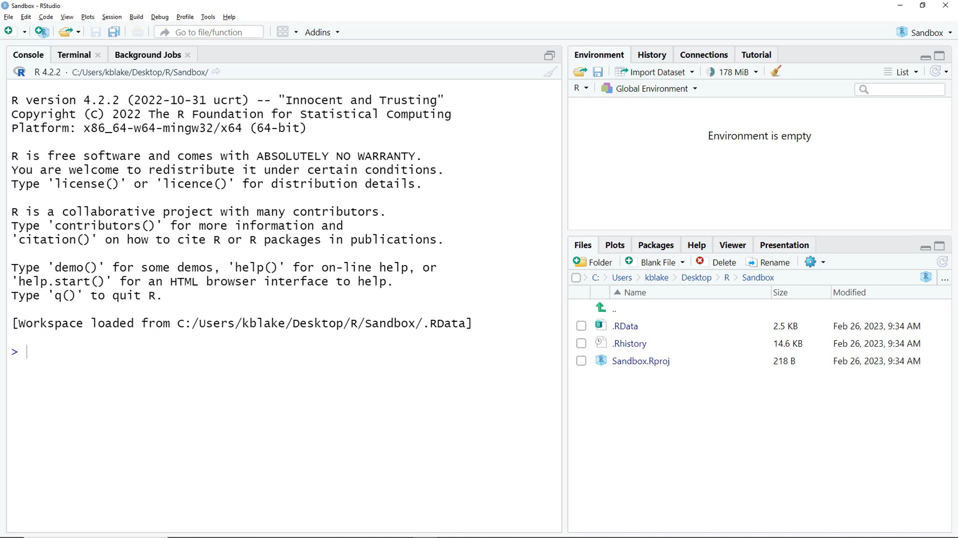
Here’s what the script looks like in action …
Video also at:
drkblake.com/dive-headfirst-into-r

